Slide 1


Webinar
Seniors Aging OUT:
Health & Community working together for safe communities for LGBTQ2+
With Jane Osborne and Ross Jenkins

Slide 2
A few housekeeping tips
All attendees will be muted during the webinar. If you are listening to this presentation via phone, remember to mute yourselves with your mute/unmute button or by pressing *6 on your keypad.
If you are experiencing issues, please let us know via the CHAT BOX or send an email to benedictes.cnpea@gmail.com
There will be a 10-15 minute Q&A at the end of the presentation. You can send your questions via chat box or email at any time during the presentation.
The presenters’ contact information is available on their bio slide if you have further questions.
At the end of the webinar, you will be invited to take a short survey about this webinar. Please take a moment to participate. Your feedback will help us improve our next webinars.

Slide 3
How to join
AUDIO VIA COMPUTER
Use your microphone and speakers.
If you are listening via phone, remember to mute yourselves with your mute/unmute button or by pressing *6
ANY TROUBLE?
- Double check the system requirements in your registration email
- Ensure that your sound is turned on/up
- Leave the session and start over
AUDIO VIA PHONE
Long distance number from Canada: ++1 (647) 497-9355
Toll free: 1 888 350 1025
Long distance number from the US: +1 (510) 365-3231
Access Code: 447-500-422
Audio PIN: Shown after joining the training

Slide 4
Tech issue/Can’t stay?
You can still participate!
The Powerpoint is also available at this link
Send any question you may have to benedictes.cnpea@gmail.com

Slide 5
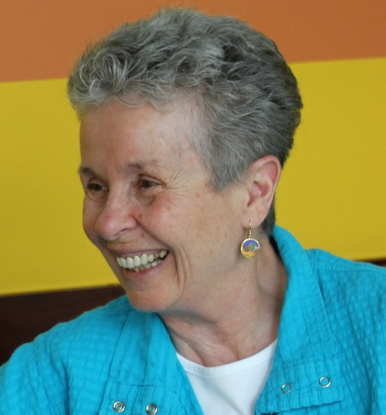
Your presenters
Jane Osborne
Jane.Osborne@bccrns.ca
After a 30-year career in information technology management and organizational development (IBM, UBC and Metro Vancouver among others), Jane retired to explore the joys of working in community. Over the past 20 years, she has focused her energies on project and volunteer work provincially and locally; initially on the North Shore of Vancouver and more recently on Central Vancouver Island, as a passionate advocate for social justice.
Jane is currently Regional Mentor with the BC Association of Community Response Networks on the Central Island. In May 2016, Jane received SFU Gerontology Research Centre’s Elder Abuse Awareness to Action Award for her work in building community partnerships and collaborations that support positive social change, coordinated responses and improved interventions for adults experiencing abuse and neglect.

Slide 6
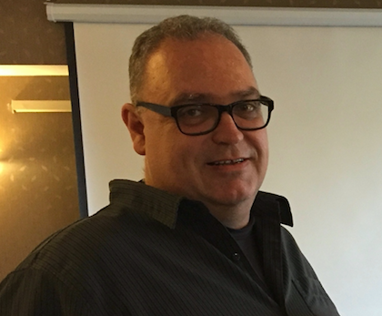
Your presenters
Ross Jenkins
ross.jenkins.inclusions@gmail.com
Ross started working with neuro-diverse populations and those with developmental delays in the early 1990’s. After several years working in the field as a community support worker, he realized that many people he worked with hadn’t received as much information about sex and sexuality as had their neuro-typical peers. In 2015, he took the Sexual Health Educator Certification course from Options for Sexual Health British Columbia with the intention of bringing sexual health information to vulnerable populations.
Late in 2016, he learned of Jane Osborne’s work with Seniors Aging Out and the BC Community Response Networks. Ross’s experience with younger adults and perspectives on diverse populations are extremely important to the challenges of creating safe and open environments for LGBTQ2+ adults as they transition into assisted living environments or begin to experience much higher needs for home support services.

Slide 7
Agenda
What is the issue? Why now?
Where have we been? Where are we now? Where are we going?
  IH Training Initiative – Nicole Tremblay
  BCCRNs Community-based Project
What are the findings (selected)?
Why the intergenerational approach? What is the importance of intersectionality?
Notes:
Jane to introduce the presentation – small personal anecdote to explain how the collaboration began

Slide 8
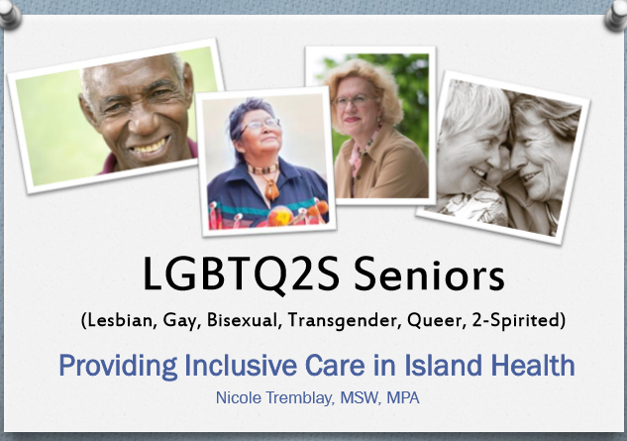

Slide 9
What is the issue?
https://www.youtube.com/watch?v=fV3O8qz6Y5g
Vera & Zayda’s story
Notes:
Nicole to explain the issue

Slide 10
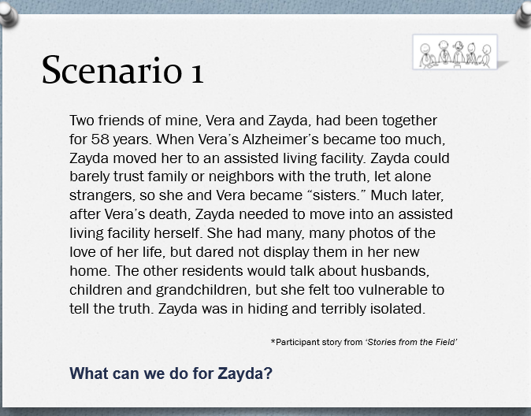
Notes:
Nicole

Slide 11
What does LGBTQ2+ mean?
Lesbian, Gay, Bisexual, Transgender, Queer & 2-spirit (IH: LGBTQ2s)
The + incorporates queer questioning, gender fluid, asexual, pansexual, …
We include allies or supporters of members of these communities
LGBTQ2+ seniors are diverse people from many backgrounds; not readily identifiable
Notes:
Nicole

Slide 12
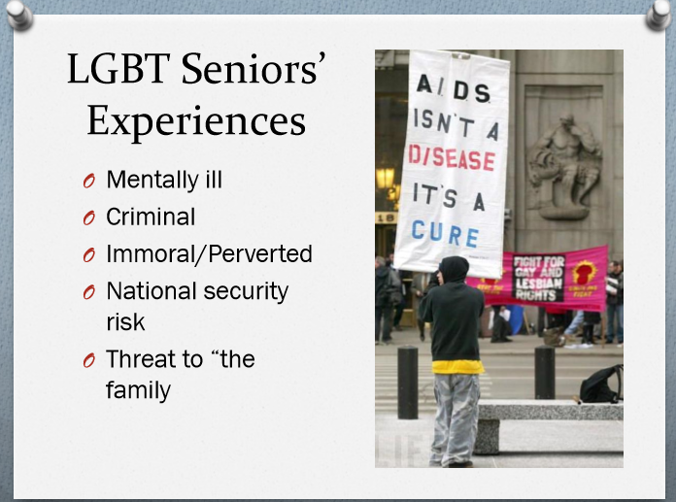
Notes:
Nicole

Slide 13
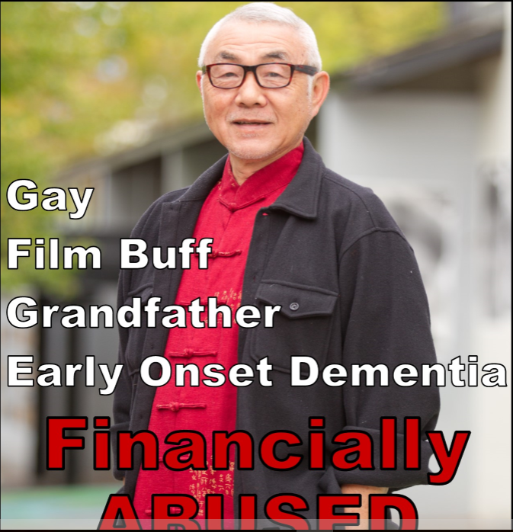
Where have we been?
Island Town Hall in Victoria
Feb. 3, 2016
  1 of 6 in province
  SFU’s Gerontology Research Centre – Gloria Gutman (Youth for Change / Quirk-e)
  Island Health – Adult Protection
  BCCRNs
  www.sfu.ca/lgbteol.html
Notes:
Jane

Slide 14
Four primary reasons we are talking about this now
Demographics
Invisible in many parts of the Island – we don’t ask; IH doesn’t collect data
LGBTQ2+ more likely to age alone
Older adults may return to the closet because of stigma; because they do not feel safe
Notes:
Jane

Slide 15
Demographics …
Younger Canadians are far more likely to say they are lesbian, gay, bisexual or transgender than older Canadians, with 10% of those aged 18 to 34 answering the question with a “yes,” compared to 2% or 3% in the four older age categories.
SOURCE: FORUM Research Poll commissioned by National Post, July 2012
In 2013 a Qmunity volunteer visited all of the residential care facilities in White Rock and the surrounding area and each facility said that none of their seniors were LGBTQ. (Mirrors the Vancouver Island experience in 2017!)
SOURCE: Qmunity.ca Aging Out Project

Slide 16
Why is it important?
LGBTQ2+ seniors need to feel safe to come out to health/community service providers – not just tolerated but welcomed & included
Voices of LGBTQ2+ seniors, supporters and allies need to inform how we provide services and supports to them as they age
As the population begins to grow, we need to ensure all communities engage to provide needed services and supports
Notes:
Jane

Slide 17
Where have we been?
Island Health Initiative
Created LGBTQ2s Advisory
Toolkit to support leaders to implement policy, practices, programs
  Includes curricula, brochures, lanyards …
Developing face to face education module
Showing Gen Silent in community
Notes:
Nicole

Slide 18
Where are we now?
Island Health Initiative
Delivering presentations to groups of health professionals, e.g. Gerontological Nurses
Preparing for Island Health wide in-house training – including visible, welcoming spaces with rainbow lanyards
Focusing on services that support clients where they live – residential care, home and community care
Notes:
Nicole

Slide 19
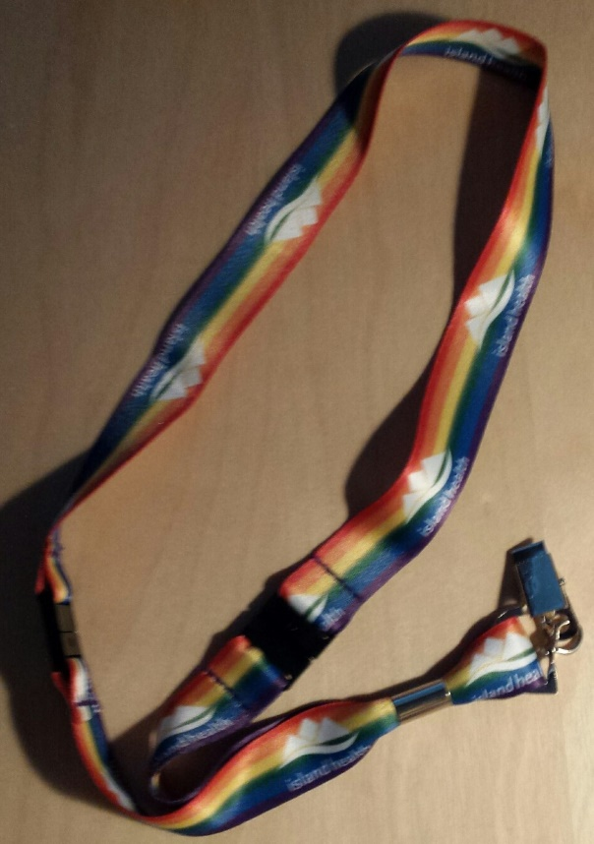
Where are we now?
Island Health Initiative
Prioritised residential care for initial training
Piloted the education module in 4 workshops in a Victoria area residential care facility
Evaluating and planning
(Nicole.Tremblay@viha.ca)
Notes:
Nicole

Slide 20
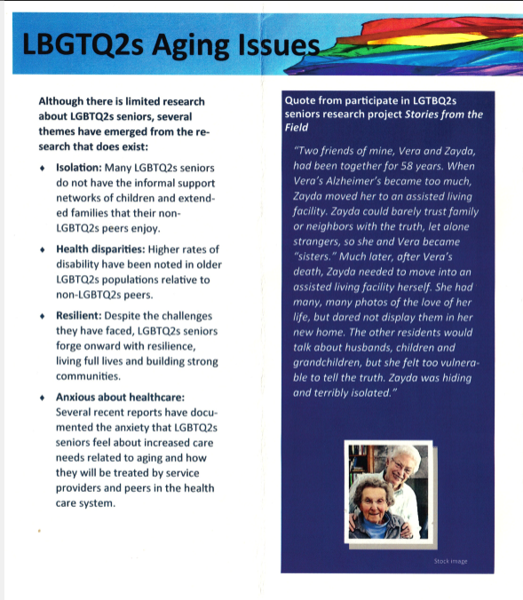
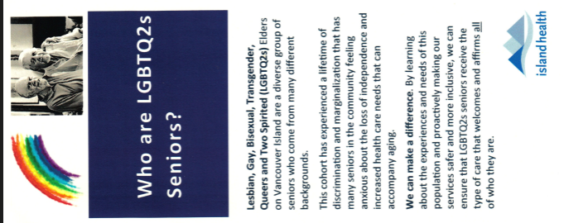
Notes:
Nicole

Slide 21
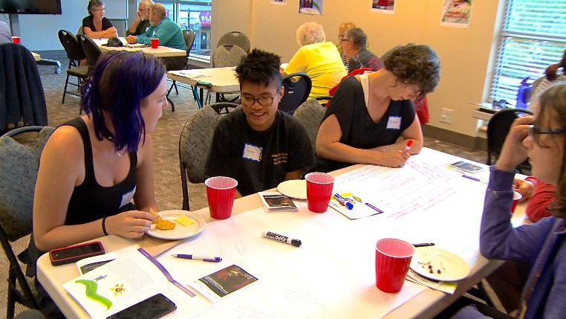
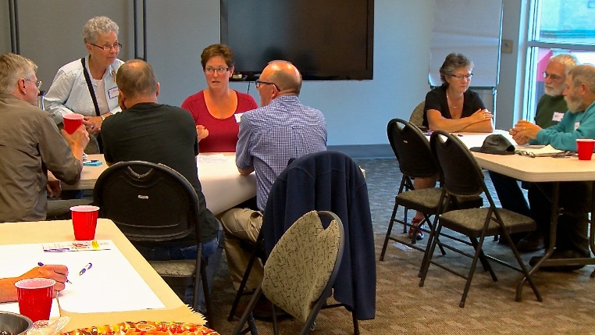
Where have we been?
BCCRNs Initiative
Nanaimo-centred working group
Initial consultation July 2016
IG partnership: Brechin United Reaching Out & Crimson Coast Dance Society
Notes:
Jane

Slide 22
Where have we been?
Creating the Team
Most members from “away” – social justice folk
Broader team / partners: people from all generations – LGBTQ2+ and allies
Core team: those willing to show up (8-10 at each meeting; 15-16 regularly contribute
Support every member to offer best skills – librarian, sex educator, nurses, social workers, community volunteers, students, …
Hands on support for IG component: recognize needs for younger people re: work, school, parenting, …
Notes:
Jane

Slide 23
Where have we been?
Setting Goals & Priorities
LGBTQ2+ seniors feel safe to come out: welcomed and included, not just tolerated.
Isolated seniors are supported in ways that work for them.
LGBTQ2+ programming is readily available and supported in community.
Broadly available resources (print and web) support LGBTQ2+ seniors in communities large and small across the province.
LGBTQ2+ seniors free from abuse and neglect.
Notes:
Jane

Slide 24
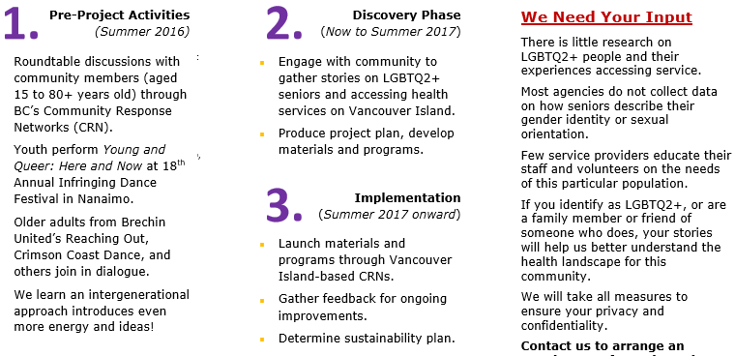
Where have we been?
Creating our Workplan
Notes:
Jane

Slide 25
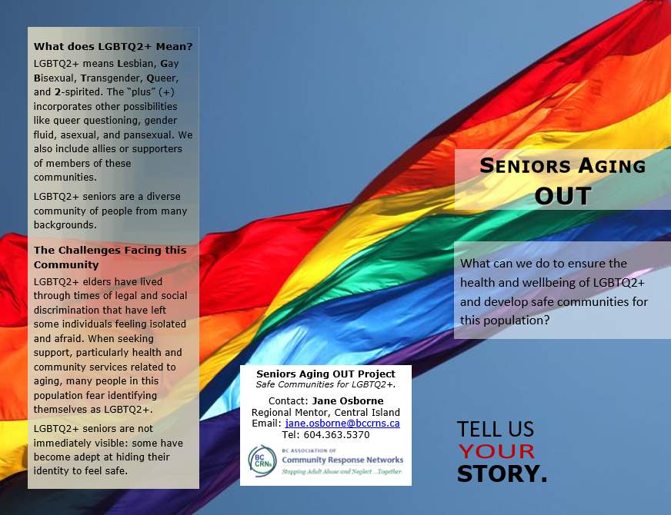
Notes:
Jane

Slide 26
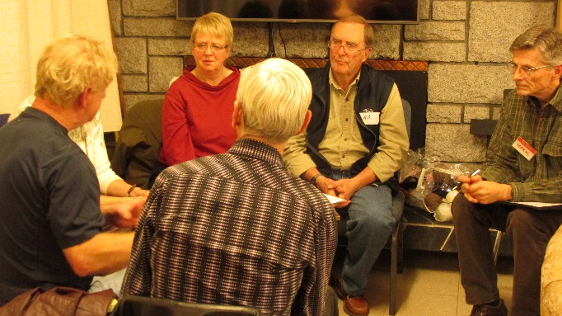
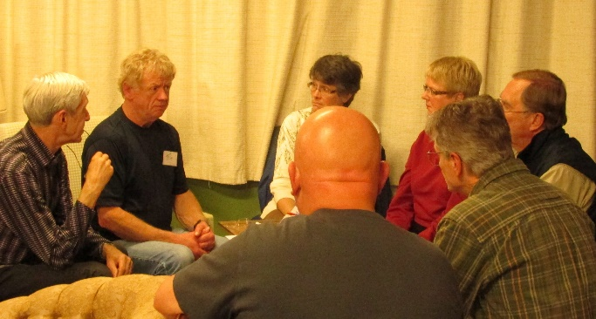
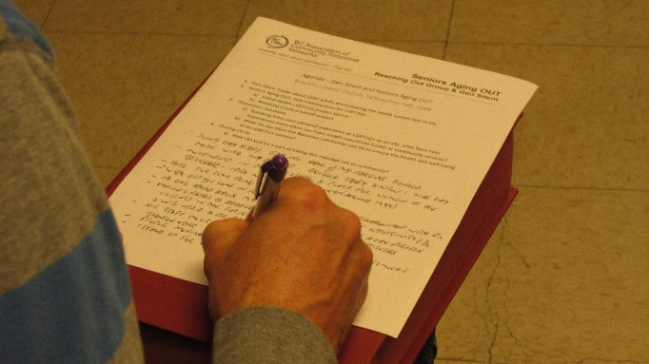
Where are we now?
Seniors Aging OUT Phase 2
Discovery (Nov 2016 – June 2017)
  Develop community outreach teams & plans
  Prepare materials for initial outreach, e.g. brochures, posters, press release, presentation
  Develop partnerships

Slide 27
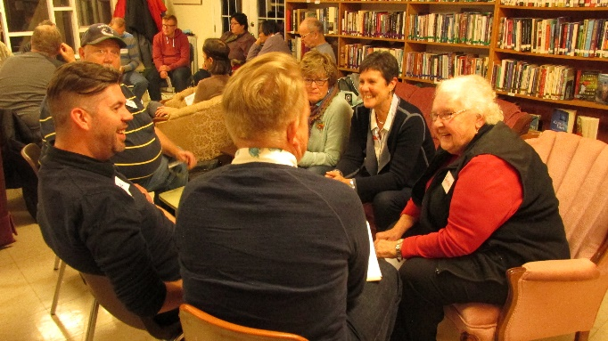
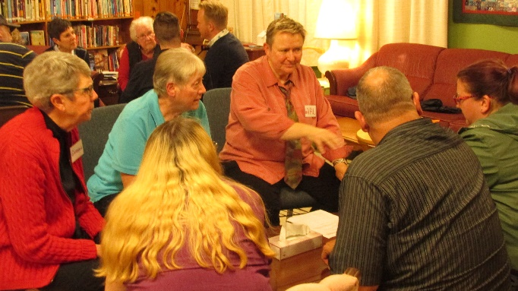
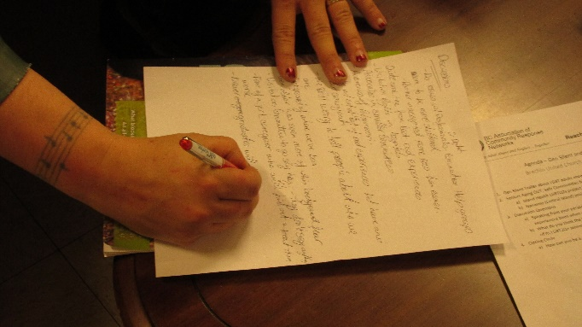
Where are we now (cont’d)?
Seniors Aging OUT Phase 2
Identify social media channels, community websites, seniors serving organization websites, community bulletin boards
Do information sessions for interested organizations and individuals
Complete research interviews / survey

Slide 28
Where are we now (cont’d)?
Seniors Aging OUT Phase 2
Individual interviews: What has your experience been? What do you need to feel “cared for”? (Dec-May)
Design & develop set of IG training materials (Jan-Jun)
Pilot materials (April-Jun)
  Nanaimo Pride Week
  WEAAD events

Slide 29
Where are we going?
Leverage (Local) Partnerships
Community-based & System
If someone else can do it for you, let them (project team members, SWs, Mental Health Clinicians, RJ facilitators, police, academics, community members) – “value of networks”
Train your team – especially when working with communities who have been traumatized
  Experiential learning in safe containers, e.g. “Building the Village”, grounded circle processes, RJ
Train partners – adjust curriculum to targets

Slide 30
Where are we going?
April to June 2017
Partnerships (selected examples):
  Our Cowichan Community Health Network – Island Health, municipalities/regions, Divisions of Family Practice, community agencies, EPIC
  Seniors Connect (CI) Project (NFLA)
  Discovery College – CSW Program
  Origin at Longwood (residential care)
  Trans Care (2-Spirit & LGBT)
  Nanaimo Association for Community Living
  Youth Advocates Network members

Slide 31
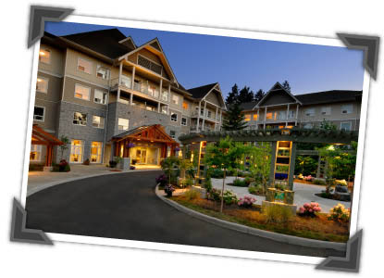
Origin at Longwood: Campus of Care
Independent / Assisted / Long Term Living

Slide 32
Origin at Longwood:
April 4th Meeting Results
Campus of care – independent living through long term care (incl. couples care)
  Willing to partner in an experiment to make Origin a community leader in welcoming and inclusion
Immediate action:
  Policies:
    Transgender (LGBTQ2+) policy for staff and residents
    (Medical marijuana and assisted dying on list of needs)
  Targeted staff education – all roles
  Resident awareness raising (Gen Silent screening)

Slide 33
Where are we going?
April - June 2017 (cont’d)
Partnerships (selected) cont’d:
  Robert Beringer – Royal Roads
    PhD Dissertation: An exploration of the non-metropolitan rewards and challenges of aging among older gay men
  Victoria Lesbian Senior Care Society
  Nanaimo Association of Family Living
  NFLA: Seniors Connect
  Community Health Services - South Nanaimo Team (under development)
  Restorative Justice – RJ Victoria, Ladysmith CJP

Slide 34
Where are we going?
April - June 2017 (cont’d)
Outreach Activities
  Screenings of Gen Silent (selected)
    Reaching Out (May 3)
    Film Societies – Cowichan, Nanaimo
    Origin at Longwood residents
  Private residential care & home care providers
    Staff training – Origin, NACL, Nurse Next Door, …
  Events
    WEAAD events centred on LGBTQ2+ INR presentations
    Nanaimo PRIDE

Slide 35
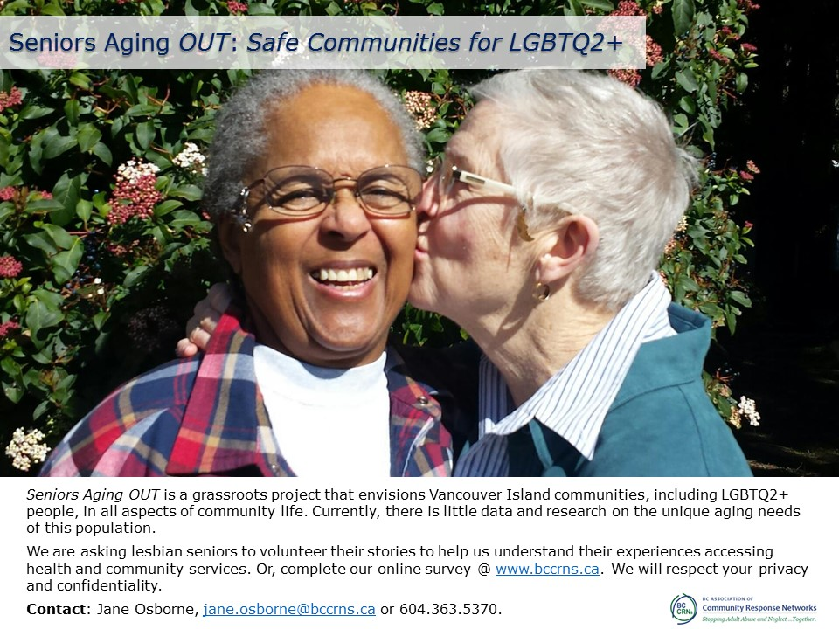

Slide 36
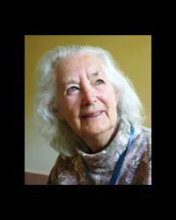
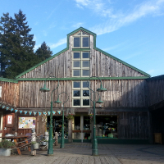
The Story of HawkOwl
90-years old, lesbian (“she thinks”)
PhD in theatre trained at three different universities, worked in the Philippines, Japan, US and Canada
Retired from UBC after 16 years as a student and then a professor
Studied Physiotherapy in Cold Mountain, Esslen and Oregon. Worked as a therapist for 12 years and retired at age 70.
Artist who creates ceramic sculptures of ancient goddesses, animals, owls, …

Slide 37
The Story of HawkOwl
Calls herself a “discreet” lesbian
  Out with her doctor when in relationship; otherwise, “Why would I be?” (different for gay males)
The Academy hasn’t always been welcoming of women – her story one of gender-based abuse framed by patriarchy and capitalism
Her life’s direction largely a reaction to being told what “she couldn’t do as well as a man”
  “My brother was expected to get an education and have a career. I was expected to do something more traditional for women, like become a kindergarten teacher.”

Slide 38
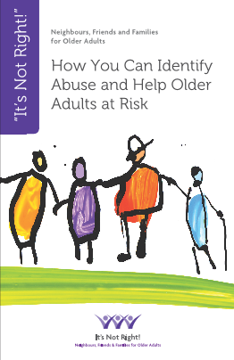
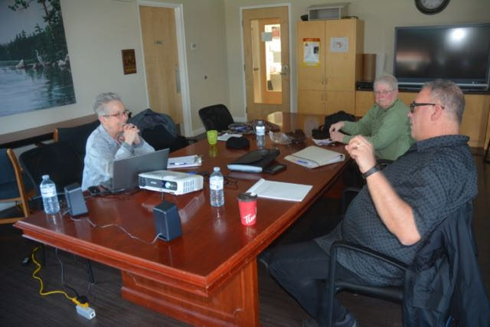
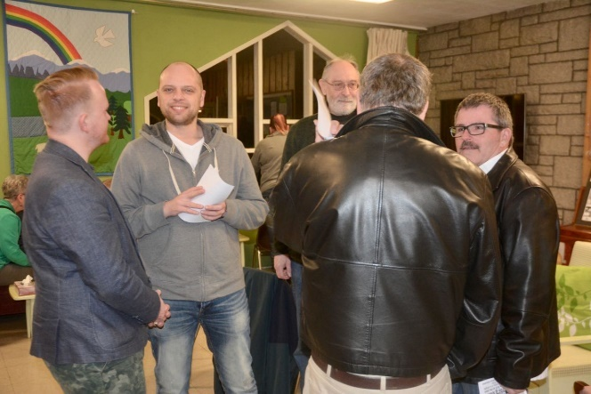
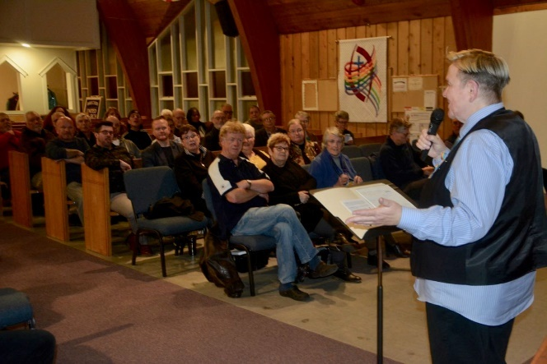
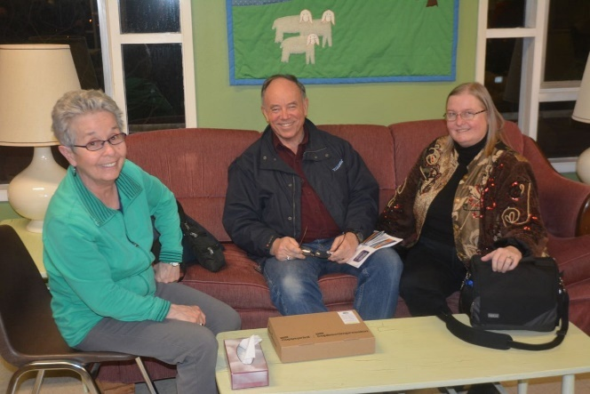
INR for LGBTQ2+ Older Adults: Need to make Queer-friendly

Slide 39
LGBTQ2+ INR: Creating culturally safe workshops
Debrief of LGBTQ2+ INR Presenters
  The Professor scenario most suitable since not quite so obviously heteronormative
    Add Doctor and/or Family Table scenarios (woman supported by a woman & man by a man);
  Framing
    Add slide or two at beginning that defines LGBTQ2+
      Recognize full range on the gender & sexuality axes
    Add self-care slide re: triggers
    Add slide with additional risks, e.g. homophobia

Slide 40
LGBTQ2+ INR: Creating culturally safe workshops
Debrief of LGBTQ2+ INR Presenters cont’d
  Welcome & Introduction
    Create a safe space with guidelines, e.g. gender neutral pronouns / preferred pronouns
    Nametags with preferred name and pronouns
  Discussion
    Written scenarios based on the permitted scenarios with genders/names that fit LGBTQ2+
    Emphasize the additional risk of social isolation for LGBTQ2+ people

Slide 41
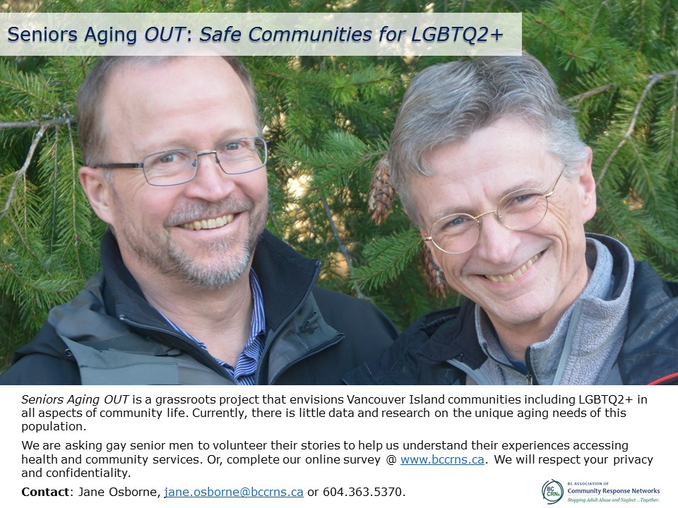

Slide 42
Some Selected Findings
LGBTQ2+ Community Needs Healing
  Older gay males hugely impacted by homophobia, criminalization, the AIDs crisis; many perceive their plight as worse than other LGBTQ2+ (examples)
  Stereotypes/labels used by some groups of LGBTQ2+ trigger others – very diverse community
Goal: LGBTQ2+ Welcoming & Inclusive Communities
  Safety the dominant need expressed early in the process – must address this need before moving to bigger goals
  Privilege a barrier between many LGBTQ2+ members in their full diversity

Slide 43
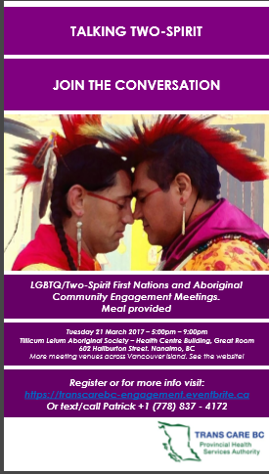
Cultural Safety in Two-Spirit and LBGT Context
Multifactored – complexity beyond anything I imagined
Layers of trauma from residential school experience combined with the LGBTQ2+ experience
Divisions between indigenous identities and First Nations (naming is very important)
Other cultural factors at play:
  Strength of connection to culture
  Coastal vs interior, urban vs rural
  Education, employment, income level

Slide 44
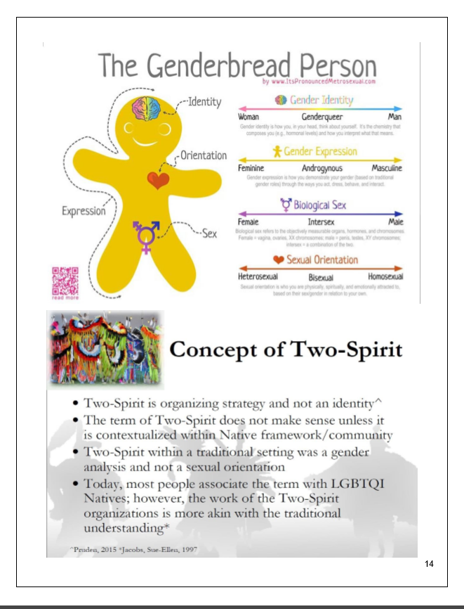
Gender, Sexual Orientation & 2-Spirit
Each unique First Nation, aboriginal or indigenous community in different phase of development around the concept of Two-Spirit and LGBTQ
Meet the community where it is and honour that place
Work together towards healing when invited to do so

Slide 45
Collective vs Individual Trauma and Safety
Individual risks for abuse and trauma:
  Gender, sexuality, age, religion, race, education, income level, place …
  Privilege conferred by membership – difficult to understand what is invisible to you
Collective (whole tribe) risks for abuse & trauma, e.g.:
  Gay males criminalized and persecuted
  Residential schools / cultural genocide

Slide 46
Why Intergenerational?
Intersectional lens – many variations even in older adult population (next section)
Western cultures separate and silo and that impedes cross-generational learning; First Nations and many eastern cultures different
Intergenerational = older & younger adults, youth
We have learned so much from younger LGBTQ2+ (Crimson Dance, Youth Advocates Network, VIU students, high school students, Transcare)

Slide 47
Intersectional Lens
Intersectionality promotes an understanding of human beings as shaped by the interaction of different social locations (e.g., ‘race’/ethnicity, Indigeneity, gender, class, sexuality, geography, age, disability/ability, migration status, religion). These interactions occur within a context of connected systems and structures of power (e.g., laws, policies, state governments and other political and economic unions, religious institutions, media). Through such processes, interdependent forms of privilege and oppression shaped by colonialism, imperialism, racism, homophobia, ableism and patriarchy are created.

Slide 48
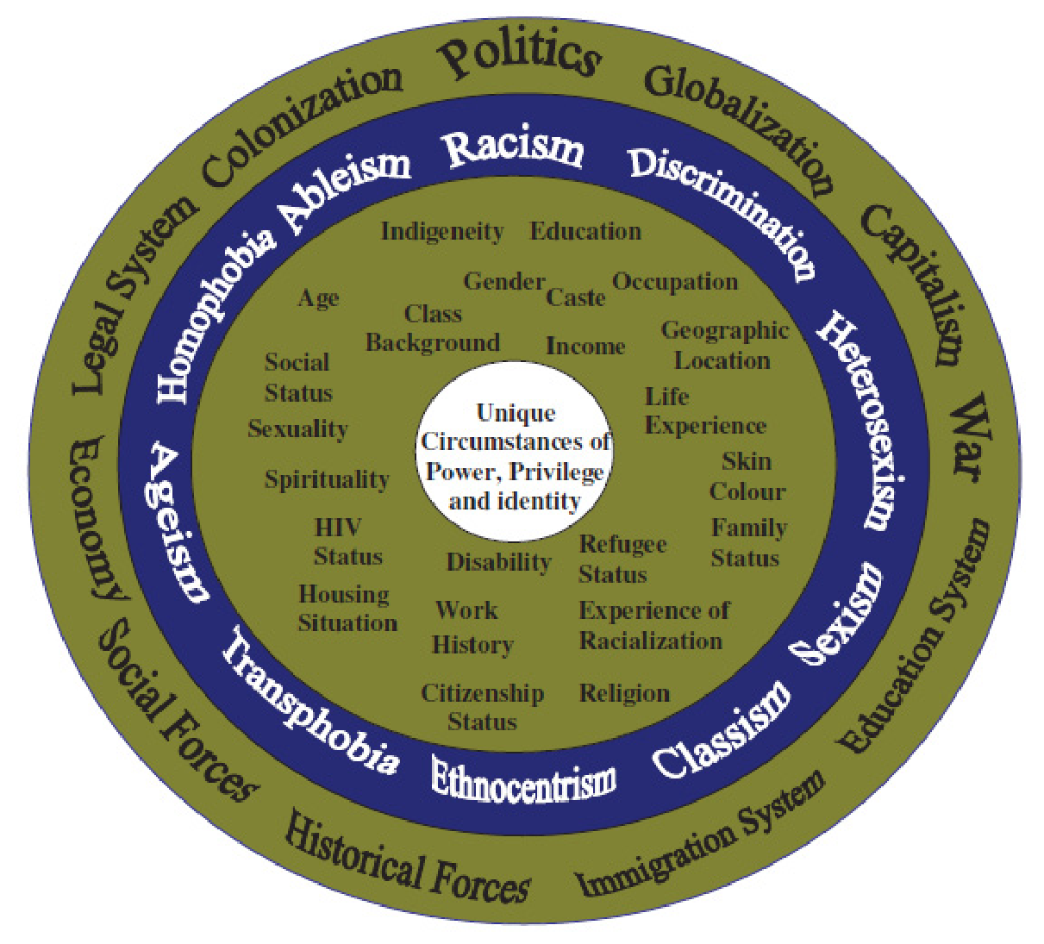
CRIAW, 2009, p. 5

Slide 49
Intersectional Lens Required (Olena Hankivsky, Intersectionality 101, 2014)
People’s lives are multi-dimensional and complex. Lived realities are shaped by different factors and social dynamics operating together.
Relationships and power dynamics between social locations and processes (e.g., racism, classism, heterosexism, ableism, ageism, sexism) are linked.
People can experience privilege and oppression simultaneously.
Intersectionality is explicitly oriented towards transformation, building coalitions among different groups, and working towards social justice.

Slide 50
Needed Refinements for Implementation Toolkit
Build models to understand LGBTQ2+ experience through an intersectional lens
Develop tools to heal LGBTQ2+ community
  Cultural safety training (similar to IH FN training)
    More scales, e.g. add gender / homophobic violence - exercise to place yourself, explore Genderbread Model
  Need intergenerational approach – older adults learn from younger, more fluid youth/adults and vice versa
Address the gap between BC coastal First Nations & urban aboriginal/indigenous groups

Slide 51
Where are we going?
Implementation – 2017/18
IH – Geography 2 & 3 (Nanaimo/Cowichan) and Geography 4 (Victoria)
  Expand program Island wide to all sectors of our communities – public and private
BC Wide
  Launch materials and programs through CRNs across the province
  Support communities that want to move ahead with creating “queer-friendly” services
Notes:
Jane

Slide 52
What Will Be in the Base Toolkit?
In place & modifiable (see samples)
  Seniors Aging OUT & IH LGBTQ2s brochures
  Senior Gay Men & Senior Lesbians posters
  Add other LGBTQ2+ posters
Gen Silent Screenings
  Movie available, discussion guideline to follow
PowerPoint Presentation & Discussion Guideline (under development)
INR Training Presentation (in discussion)

Slide 53
What Will Be in the Augmented Toolkit?
Research (survey/interview) Findings
  Seniors Aging OUT & Robert Beringer research
LGBTQ2+ Training Outlines (in process):
  Island Health: LGBTQ2s Training Outline
  Seniors Aging OUT: Community Agency Staff & Volunteers Training Outline
Cultural Safety Training Outline (early 2018)
  Partnership between IH, Cultural Safety trainers (IH & MCFD) and Seniors Aging OUT project

Slide 54
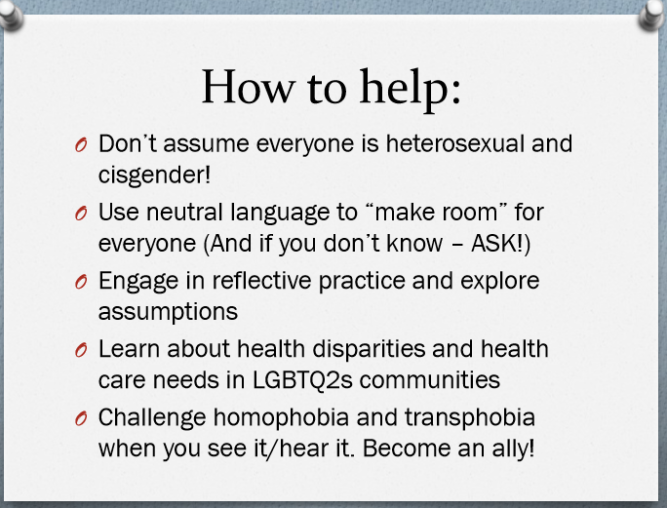

Slide 55
Questions / Discussion
?
Where is your region or community in relation to this issue?
What are the gaps? The challenges?
How can we work together and support each other as CRN-connected people?

Slide 56
Thank you!
Please take a minute to answer a few quick questions about your experience of this webinar. Click on this link or copy/paste it in your browser:
https://goo.gl/forms/5VWv7c7I7gbKPqG02
Deadline: June 14, 2017
Stay in touch with us
Twitter: @cnpea
Facebook: www.facebook.com/cnpea
Questions/Comments: benedictes.cnpea@gmail.com
And don’t forget to tag #IGDayCa and #WEAAD2017!

