Slide 1




Welcome to webinar #456
November 5, 2015 1:00 – 2:30 PM Eastern Time
(Teleconference open for participants at 12:50 ET)
Financial Abuse of Older Adults:
Recognize, Review and Respond
Presenters:
Donna Bailey
Director, Research & Client Solutions for CUSOURCE Credit Union Knowledge Network
Kate Martin
Policy Analyst, Credit Union Central of Canada
www.chnet-works.ca
Canadian Health Human Resources Network
University of Ottawa

Slide 2


Housekeeping : how a webinar works…
Step #1: Teleconference
All Audio by telephone
  If your line is ‘bad’ – hang up and call back in
  Participant lines muted
  Recording announcement
Step #2: The Internet Conference (via ‘ADOBE CONNECT’)
No audio via internet
  SEE the PowerPoint being shown.
  Post your comments/questions.
  See postings from your colleagues.
  Join in the interactive polls.
Difficulties? You can still participate! (use the back up PowerPoint - post your comments via email)
Step #3: Back up PowerPoint Presentation
www.chnet-works.ca
For assistance: animateur@chnet-works.ca
Notes:
Housekeeping announcements.

Slide 3


How to post comments/questions during the webinar
Joining in by
Telephone
+
Adobe Connect Internet Conference
Use the text box!
Please introduce yourself!
Name
Organization
Location
Group in Attendance?
Joining by
Telephone +
Backup PowerPoint
Respond to the ‘access instructions email
animateur@chnet-works.ca

Slide 4
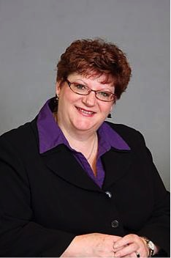
Presenters
Donna Bailey
Director, Research & Client Solutions for CUSOURCE Credit Union Knowledge Network
Donna is a learning and development and client relations professional. She excels at developing and managing staff and client relationships in the financial co-operative system.
A strategic thinker, she has demonstrated leadership through her ability to build high performing teams in a variety of settings. Adept at creative problem solving, and with a proven ability to work with internal and external customers, Donna is passionate about achieving corporate strategic priorities.
Personal strengths include an exceptional ability to build trust quickly, a positive can-do attitude, high energy and a quest for lifelong learning. In June 2003, Donna completed her MBA from Athabasca University with her applied project in the area of Organization Vitality and in 2015 achieved the CTDP (Certified Training and Development Professional) certification. A believer in giving back to the community, Donna has volunteered with many community organizations, including the Ontario Co-operative Association, Ontario Natural Food Coop, Big Brothers and Big Sisters Board of Directors.

Slide 5
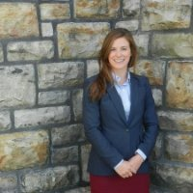
Presenters
Kate Martin
Kate Martin works as a policy analyst for the credit union system, where her work focuses on sustainable banking and government relations. Kate has participated in the Parliamentary Internship Program at the House of Commons and completed an MA in History from the University of Victoria, where she had the opportunity to study the potential for reconciliatory relationships between Indigenous peoples and settler peoples in British Columbia.

Slide 6
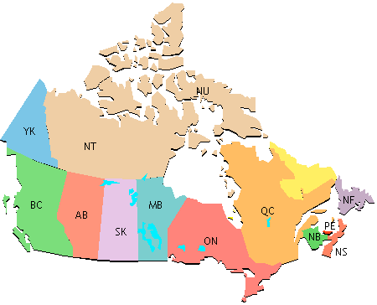
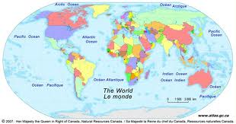
What province/territory are you from?
Answer via Adobe Connect :
Poll OR RSVP to access instruction email
  BC
  AB
  SK
  MB
  ON
  QC
  NB
  NS
  PEI
  NL
  YK
  NWT
  NU
  Other

Slide 7







Who is joining in?
Adobe Connect Poll
OR RSVP to access instruction email
√ What sector are you from?
  √ Public Health
  √ Education
  √ Research
  √ Govt/Ministry
  √ Health practitioner
  √ NGO
  √ Other?

Slide 8

Who is joining in?
Adobe Connect Poll
OR RSVP to access instruction email
What is your role?
  Research
  Practitioner
  Manager
  Decision Maker
  Policy Maker
  Community Leader
  Other

Slide 9

Re: Your Involvement
Adobe Connect Poll
OR RSVP to access instruction email
Are you currently working on this issue?
  Yes
  No

Slide 10
Your comments/questions please!
Joining in by:
Telephone
+
Adobe Connect Internet Conference
Use the Text Box…
Let us know…
Which presenter the question is for…
If you are referring to a particular slide …
Joining by Telephone
+
Backup PowerPoint Presentation?
By email:
Respond to the
‘access instructions email
animateur@chnet-works.ca

Slide 11

Preventing Financial Abuse of Older Adults
Webinar
November 5, 2015
Canadian Network for the Prevention of Elder Abuse in partnership with CHNET-Works!
Webinar
November 5, 2015
Canadian Network for the Prevention of Elder Abuse
Notes:
Kate Martin
Thanks for joining us
Explain objective of webinar: provide an overview of how the CU system is working to provide education to prevent financial abuse of older adults

Slide 12
Presenters
Donna Bailey, Director, Research & Client Solutions for CUSOURCE Credit Union Knowledge Network
Kate Martin, Policy Analyst, Credit Union Central of Canada
Notes:
Kate Martin
Who you’ll be hearing from today

Slide 13






Credit Union Central of Canada system
Le système de la Centrale des caisses de crédit
(second quarter, 2015)
(deuxième trimestre, 2015)
5,356,702 members / membres
Own
possèdent
303 credit unions / caisses de crédit
operating 1,745 branches in BC, AB, SK, MB, ON, NS, NB, PEI and NL
Own
possèdent
5 regional centrals & 1 federation
5 centrales régionales et une fédération
Own
possèdent
National association with offices in Toronto & Ottawa
Association nationale, bureaux à Toronto et Ottawa.
Notes:
Kate Martin to provide brief overview of credit union system in Canada

Slide 14
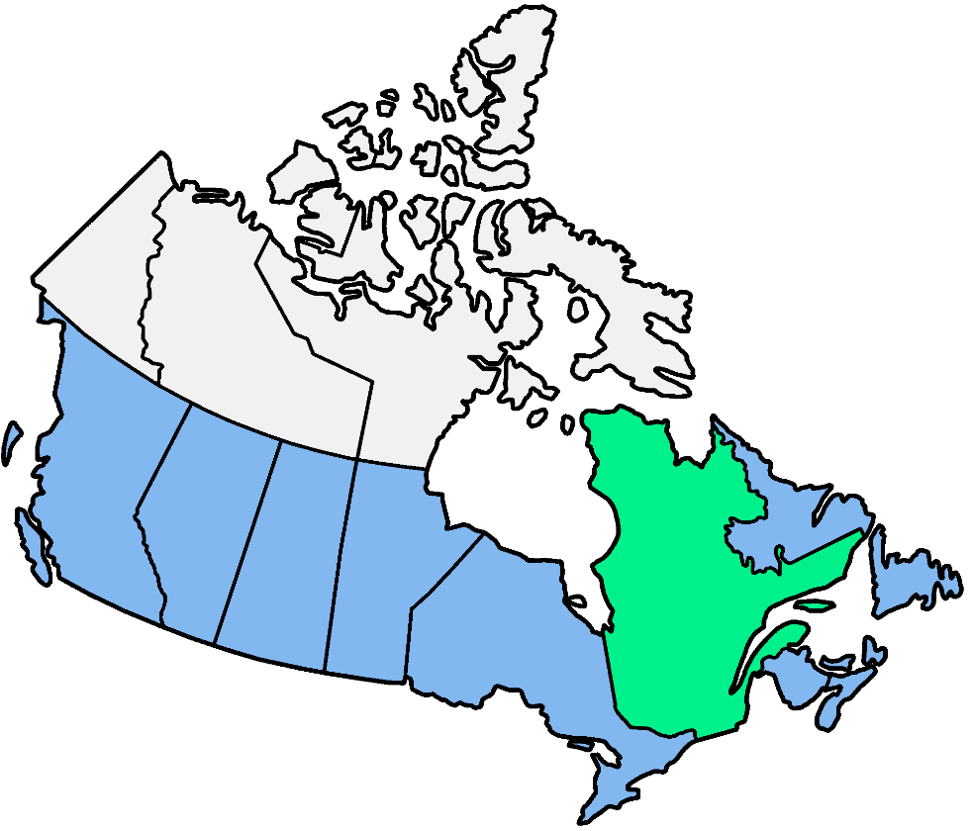
Canadian credit union sector
Secteur des caisses de crédit du Canada
Operating in nine provinces
Présentes dans neuf provinces
5.35 million members (20% of pop)
5,35 millions de membres (20 % de la pop.)
42
28
9
$177.7 billion in assets
177,7 $ milliards en actifs
49
36
321
114
7
25
28
9
Provincially-chartered credit unions – Caisses de crédit à charte provinciale
Credit Union Central of Canada system and non-affiliated – CUCC et non affiliiés
Desjardins Group – Caisse Desjardins
Jurisdictions without credit union legislation – Juridictions sans législation sur les caisses de crédit
 | BC | AB | SK | MB | ON | QC | NB | NS | PE | NL
Members Membres | 1,917,446 | 637,400 | 473,372 | 635,825 | 1,552,388 | 4,412,523 | 224,663 | 150,375 | 52,286 | 54,406
% pop. | 41% | 15% | 42% | 49% | 11% | 54% | 30% | 16% | 36% | 10%
Assets/Actifs ($B) | $64.32 | $23.46 | $20.25 | $26.26 | $44.67 | $151.91 | $4.21 | $2.23 | $0.89 | $1.12
Notes:
Kate Martin to provide brief overview of credit union system in Canada

Slide 15















Credit unions
Caisses de credit
The 15 largest
Les 15 plus grandes
and 288 others …
et 288 autres …
Notes:
Kate Martin to provide brief overview of credit union system in Canada

Slide 16
Today’s presentation
1
Introduction: What’s financial abuse? What’s the role for credit unions?
2
Development of course: Financial Abuse of Older Adults: Recognize, Review and Respond
Preview of Financial Abuse of Older Adults: Recognize, Review and Respond
3
4
Share successes and next steps
Notes:
Kate Martin to introduce presentation

Slide 17
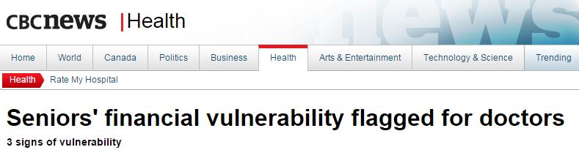
What’s the issue?
Elder abuse is a universal problem. It is prevalent everywhere. Abuse can occur anywhere, by anyone, but frequently it is family, institutional and social.
Notes:
Kate Martin to introduce the topic of elder abuse + financial abuse
Elder Abuse is a universal problem. It is prevalent everywhere. Abuse can occur anywhere, by anyone, but frequently it is family, institutional and social.
The prevention of elder abuse and neglect has received an increased focus in Canada in recent years. With the population of older adults increasing in Canada, continued training, awareness and support activities are required to respond to an increase in incidents of elder abuse and neglect.
Throughout the world, abuse and neglect of older adults largely remains under-recognized, or a hidden problem. No community or country in the world is immune from this social problem.
Raising awareness and prevention of elder abuse requires the involvement of everyone.

Slide 18
Financial abuse
The misuse of an older adult’s money or belongings by a person the senior trusts. It is generally defined as an action or a series of actions that occur as part of an ongoing relationship and often happens in connection with other types of abuse.
Notes:
Kate Martin:
A component of elder abuse is financial abuse. Financial abuse is a pressing issue for Canadians. It’s the most commonly reported types of elder abuse in Canada, but often goes unreported
Financial abuse is understood as involving “the misuse of an older adult’s money or belongings by a person the senior trusts. It is generally defined as an action or a series of actions that occur as part of an ongoing relationship and often happens in connection with other types of abuse.”
What can it look like?
Powers of Attorney (PoAs) and joint bank accounts are tools to assist seniors and others manage their financial affairs. And while these tools can be very useful, the most common scenarios associated with the financial abuse of seniors are related to the misuse of PoAs and joint bank accounts.

Slide 19
What can financial abuse look like?
    Misuse or theft of senior’s finances
    Taking money without permission
    Forging signature or altering documents
    Gifts made under coercion
    Unduly pressuring, forcing or tricking change in a will, or other legal documents
Notes:
Kate Martin:
What can it look like?
Powers of Attorney (PoAs) and joint bank accounts are tools to assist seniors and others manage their financial affairs. And while these tools can be very useful, the most common scenarios associated with the financial abuse of seniors are related to the misuse of PoAs and joint bank accounts.
Some common examples of financial abuse of seniors include:
misuse or theft of a senior’s assets, property or money (often from joint bank accounts or through improper use of PoAs
taking a senior’s money or cashing their cheques without their permission
forging a senior’s signature or altering documents to get permission to access or dispose of assets
monetary gifts that are involuntary—e.g., gifts made under coercion, undue influence or threats
unduly pressuring, forcing or tricking a senior to make or change a will, or to sign legal documents that gives away the senior’s property or obligates the senior for something for which the senior does not benefit, as well as:
pressuring a senior to obtain a mortgage they don’t need, where the proceeds are used by a relative or
having the senior sign a guarantee or pledge their property as security for someone else’s loan
pressuring a senior to give money or write cheques for that person or to someone else that person directs
sharing a senior’s home without paying a fair share of the expenses when requested
failing to repay loans provided by a senior
predatory marriage, where a person deliberately pressures an older person of limited capacity into marriage solely for financial profit.

Slide 20
Role for credit unions
Of credit union members are 65 years old, or older
5th co-op principle: Member education
7th co-op principle: Concern for community
3rd goal: Prevent and protect against fraud and financial abuse
Notes:
Kate Martin:
Demographics: Financial abuse is of particular concern given that more than one-quarter (25.6 per cent) of our members are at 65 years of age or older.
What’s more: This issue impacts the largest segment within the credit unions – older members: 47.1 % of credit union members are either retired or close to retirement age, or eligible for early retirement.
It’s also about raising awareness throughout the system: this is an issue that could touch us all at some point.
Putting their financial well-being first is part of the credit union difference.
Member education: As co-operatives, credit unions are driven by seven principles of the international co-operative movement that profoundly influence the values, governance, culture and business decisions of credit unions in Canada and around the world.
One of these principles states that co-operatives should strive to provide their members with “education, training and information.”
Financial Abuse of Older Adults: Recognize, Review and Respond, continues the credit union tradition of providing education, training and information so that the credit union system can better confront one of the most common forms of elder abuse: financial abuse
Credit unions have honoured this principle during Financial Literacy Month by offering a wide variety of financial education programs specific to their members. These are aimed at helping them better understand the choices available to meet their financial challenges, opportunities and responsibilities.
Concern for community: Credit unions are a vital contributor to the Canadian economy, putting billions in lending into the economy and providing services to more than 5.3 Canadians. We are the second largest lenders to small business (after the Royal Bank – who is multiple times larger), and always come out on top of service to customers – both on behalf of the CFIB and the IPSOS Reid Best banking service awards.
But credit unions have always been about more than just banking. Our unique co-operative structure allows us to consider the overall benefits and positive impacts that we are having in communities, which leads to a concern about the financial health of the communities credit unions serve. For this reason, we work as a system to identify pressing issues where credit unions can have an impact, financial abuse being one of them.
National strategy for financial literacy: Goal 3 of national strategy
3. Prevent and protect against fraud and financial abuse
Anyone can fall victim to financial fraud. New scams emerge constantly, aiming to trick people into taking actions that result in losing their money to fraudsters. Canadians need to be aware of the signs to watch for and how to minimize the risks. If they think they’re a victim of fraud, they should know where they can go to seek help, such as the Canadian Anti-Fraud Centre. Older Canadians, in particular, are frequently targeted for certain types of fraud and may also be vulnerable to financial abuse. Education and prevention initiatives can help protect Canadians from such abuse or fraud. Advancing this goal will rely heavily on strong networks for the prevention of fraud and financial abuse that are active in many regions of the country.​
→ Combined with requests from the system to address financial abuse at credit unions, these factors combined to make

Slide 21
Today’s presentation
1
What’s financial abuse? What’s the role for credit unions?
2
Development of course: Financial Abuse of Older Adults: Recognize, Review and Respond
3
Preview of Financial Abuse of Older Adults: Recognize, Review and Respond
4
Share successes and next steps
Notes:
Kate Martin to situate presentation

Slide 22
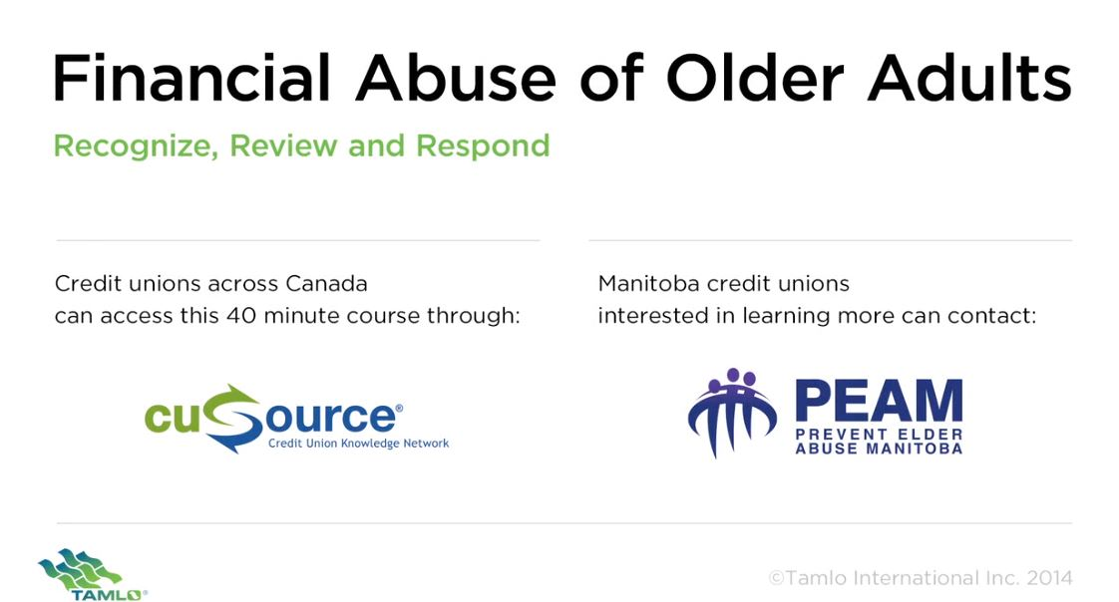
Financial Abuse of Older Adults: Recognize, Review and Respond
Notes:
Kate Martin
Fittingly released in conjunction with the closing of Canada’s fourth Financial Literacy Month and designed for credit unions with the support of FCAC and help of experts from Prevent Elder Abuse Manitoba, Financial Abuse of Older Adults: Recognize, Review and Respond provides solutions, tools and resources to allow staff to be better able to:
Recognize situations in which older credit union members are being financially abused;
Identify the type and method of financial abuse in each situation;
Report the financial abuse to a supervisor or manager;
Select an appropriate response to the financial abuse;
Inform the member of the options available to leave the financial abuse;
Provide the member with appropriate community resources;
Demonstrate knowledge of the credit union’s legal and ethical limits in reporting and responding to financial abuse; and
Monitor the outcome of the member’s situation.

Slide 23



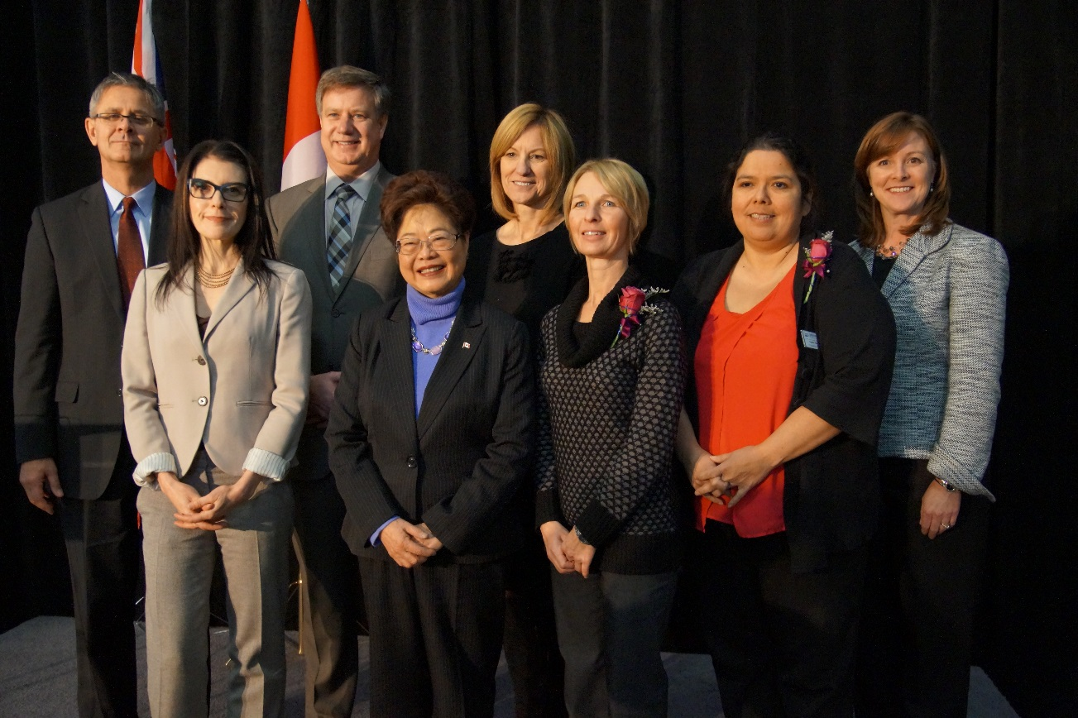


Partners
Notes:
Kate Martin
A great strength within the credit union system is the connection with local communities. This strengthen has contributed to the success development of the course.
Highlight collaboration and development and who did what:
The program was written and developed by Tamlo International Inc. and will be distributed exclusively by CUSOURCE Credit Union Knowledge Network, a wholly owned subsidiary of Credit Union Central of Canada that provides learning and development solutions to the Canadian credit union system.
Fittingly released in conjunction with the closing of Canada’s fourth Financial Literacy Month and designed for credit unions with the support of FCAC and help of experts from Prevent Elder Abuse Manitoba
The launch was held at the Good Neighbours for Active Living Centre and featured remarks by the Honourable Alice Wong, federal Minister of State for Seniors; the Honourable Deanne Crothers, Manitoba Minister of Healthy Living and Seniors; Jane Rooney, Financial Literacy Leader; Ted Richert, Vice President, Credit Union Central of Manitoba; and Martha Durdin, President and CEO of Credit Union Central of Canada.
Initial funding for Financial Abuse of Older Adults: Recognize, Review and Respond was provided to Prevent Elder Abuse Manitoba through the Government of Canada’s New Horizons for Seniors Program (NHSP).

Slide 24
Today’s presentation
1
What’s financial abuse? What’s the role for credit unions?
2
Development of course: Financial Abuse of Older Adults: Recognize, Review and Respond
3
Preview of Financial Abuse of Older Adults: Recognize, Review and Respond
4
Share successes and next steps
Notes:
Kate Martin to situate presentation – hand presenter rights to Donna Bailey

Slide 25

What are some of the solutions offered?
Three stories based on real life accounts faced by credit union employees
Each story shows how a credit union employee successfully helped a member
Abuse of assets, abuse of credit, abuse of power of attorney
Identify signs and red flags of financial abuse
Clarify the expectation for employees and how you can help
Links to additional information and local resources
Notes:
Donna Bailey

Slide 26
Preview
http://files.cusource.ca/yourknowledge/ComplianceTrainingResources/FAOA-Trailer-1-HD.mp4
Notes:
Donna Bailey to introduce preview

Slide 27
Today’s presentation
1
What’s financial abuse? What’s the role for credit unions?
2
Development of course: Financial Abuse of Older Adults: Recognize, Review and Respond
3
Preview of Financial Abuse of Older Adults: Recognize, Review and Respond
4
Share successes and next steps
Notes:
Donna Bailey to situate presentation

Slide 28
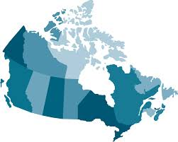

Number of employees
British Columbia | 152
Alberta | 134
Saskatchewan | 126
Manitoba | 1101
Ontario | 290
New Brunswick | 47
Nova Scotia | 94
Prince Edward Island | 11
Newfoundland and Labrador | 36
Total number of credit union employees in Canada:
1991
Notes:
Donna Bailey
Numbers based on October 2015 report

Slide 29
Impact on work
91.24%
agreed that the course increased awareness and understanding of financial abuse of older adults
91.83%
agreed that the course increased understanding of role in preventing financial abuse of older adults
89.35%
agreed that the course increased confidence in intervening when concerned about an older adult
89.85%
agreed that the course increased understanding of situations that should be brought to the attention of the manager.
89.64%
agreed that the course increased their ability to respond with appropriate solutions
Notes:
Donna Bailey
Numbers from October 2015 report
“Somewhat agree” + “Strongly agree”

Slide 30

Impact on work
Most important thing they learned
“The most important thing is that you can do something. Makes me more aware of different things I can do to try to help more than just say "that's too bad".”
“Makes me want to do more if I ever come across this situation again in my life time not only in work but something useful you can use in life”.
Notes:
Donna Bailey

Slide 31

Impact on work
Most important thing they learned
It's ok to be concerned about our members and ask questions if you think there is a problem.
If something doesn't seem right or if the behavior of a member seems unusual or out of character, investigate and talk to the member in a respectful way to get to the bottom of the issue.
Notes:
Donna Bailey

Slide 32
Spotlight on Manitoba’s experience
Working with CUCM to inform all Manitoba credit unions has been instrumental to our success
Portage Credit Union has included the course as mandatory training for all employees
Cambrian Credit Union is rolling out training to all of its front line workers
Steinbach Credit Union is rolling out the training to branch manager to include in the branch training strategy
Notes:
Kate Martin to highlight Manitoba’s experience

Slide 33


Community presentations in Manitoba
Notes:
Kate Martin to highlight community presentations

Slide 34



Additional opportunities
Notes:
Kate Martin to explain additional opportunities to raise awareness about financial abuse as a result of this course

Slide 35
Resources
National Strategy For Financial Literacy Phase 1: Strengthening Seniors’ Financial Literacy http://www.fcac-acfc.gc.ca/Eng/financialLiteracy/financialLiteracyCanada/strategy/Documents/seniors_financial_literacy_consultation.pdf
Stratégie nationale pour la littératie financière Étape 1 : Renforcer la littératie financière des aînés http://www.fcac-acfc.gc.ca/Fra/litteratieFinanciere/litteratieCanada/Documents/SeniorsStrategyFR.pdf
What every older Canadian should know about Powers of Attorney (for financial matters and property) and Joint Bank Accounts http://www.seniors.gc.ca/eng/working/fptf/pdf/brochure_attorney.pdf
Ce que tous les Canadiens âgés devraient savoir au sujet des procurations (pour la gestion des finances et des biens) et comptes conjoints http://www.aines.gc.ca/fra/service/ffpt/pdf/brochure_procurations.pdf
Exploitation financière par des membres de famille et les soignants: Les principales arnaques contre les personnes âgées commis par des étrangers http://www.elderabuseontario.com/wp-content/uploads/2015/02/Exploitation-Financi%C3%A8re-Par-Des-Membres-De-Famille-Et-Les-Soignants-feb-24.pdf
Where to Report and Access Assistance for Situations of Financial Abuse http://www.elderabuseontario.com/wp-content/uploads/2015/02/Where-to-report-and-access-assistance-Financial-Abuse.pdf
En cas de rapport et où accéder à l'assistance dans les situations d'abus financiers http://www.elderabuseontario.com/wp-content/uploads/2015/02/En-cas-de-rapport-et-o%C3%B9-acc%C3%A9der-%C3%A0-lassistance-dans-les-situations-dabus-financiers-Feb-24.pdf
Keep Your Money Safe – What you need to know http://www.elderabuseontario.com/wp-content/uploads/2014/04/EAO_Woman_Front.pdf
Notes:
Kate Martin to note resources

Slide 36
Questions?
Donna Bailey, Director, Research & Client Solutions for CUSOURCE Credit Union Knowledge Network
BaileyD@cusource.ca
Kate Martin, Policy Analyst, Credit Union Central of Canada
MartinK@cucentral.ca

Slide 37

Stay in touch with the CNPEA
Find other useful resources and publications, stay up-to-date on future webinars or book one for your organization at www.cnpea.ca
Please take a minute to answer a few quick questions about your experience of this webinar: http://fluidsurveys.com/surveys/cnpea/cnpea-webinar-feedback/
Please fill out this online feedback form by Thursday November 12, 2015.
(If this link is not working, copy and paste it into an internet browser)
Twitter: @cnpea

