Slide 1




Welcome to webinar #462
January 20, 2016
1:00 – 2:30 PM Eastern Time
(Teleconference open for participants at 12:50)
Police Practice to Counter Elder Abuse
Presenters:
Marie Beaulieu
Michelle Côté
www.chnet-works.ca
Canadian Health Human Resources Network
University of Ottawa

Slide 2


Housekeeping : how a webinar works…
Step #1: Teleconference
All Audio by telephone
  If your line is ‘bad’ – hang up and call back in
  Participant lines muted
  Recording announcement
Step #2: The Internet Conference (via ‘ADOBE CONNECT’)
No audio via internet
  SEE the PowerPoint being shown.
  Post your comments/questions.
  See postings from your colleagues.
  Join in the interactive polls.
Difficulties? You can still participate! (use the back up PowerPoint - post your comments via email)
Step #3: Back up PowerPoint Presentation
www.chnet-works.ca
For assistance: animateur@chnet-works.ca
Notes:
Housekeeping announcements.

Slide 3


How to post comments/questions during the webinar
Joining in by
Telephone
+
Adobe Connect Internet Conference
Use the text box!
Please introduce yourself!
Name
Organization
Location
Group in Attendance?
Joining by
Telephone +
Backup PowerPoint
Respond to the access instructions email
animateur@chnet-works.ca

Slide 4
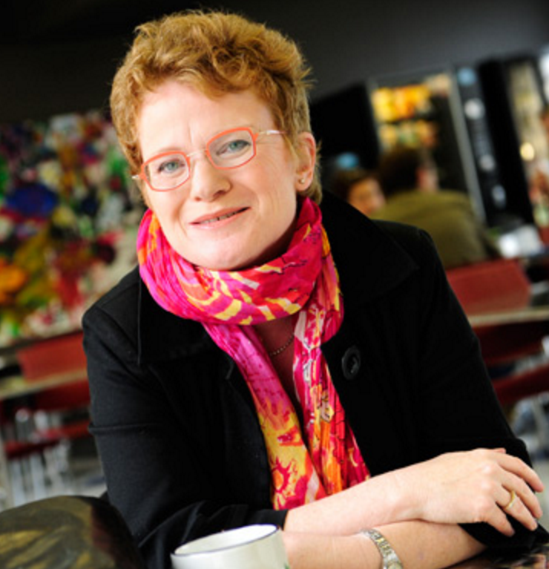
Presenters
Marie Beaulieu, Ph.D
Professor, School of Social Work, University of Sherbrooke.
Chairholder, Research Chair on mistreatment of older adults.
Principal Investigator IPAM project.

Slide 5

Presenters
Michelle Côté, Ph.D
Head of Research and Strategic Planning Division, SPVM.
Co-investigator IPAM project.

Slide 6
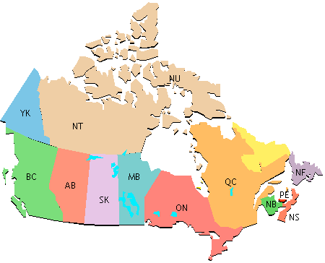
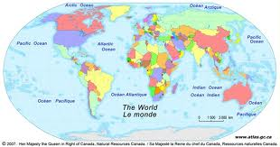
What province/territory are you from?
Answer via Adobe Connect :
Poll OR RSVP to access instruction email
  BC
  AB
  SK
  MB
  ON
  QC
  NB
  NS
  PEI
  NL
  YK
  NWT
  NU
  Other

Slide 7







Who is joining in?
Adobe Connect Poll
OR RSVP to access instruction email
√ What sector are you from?
  √ Public Health
  √ Education
  √ Research
  √ Govt/Ministry
  √ Health practitioner
  √ NGO
  √ Police Service
  √ Other?

Slide 8

Who is joining in?
Adobe Connect Poll
OR RSVP to access instruction email
What is your role?
  Research
  Practitioner
  Manager
  Decision Maker
  Policy Maker
  Community Leader
  Other

Slide 9

Re: Your Involvement
Adobe Connect Poll
OR RSVP to access instruction email
Are you currently working on this issue?
  Yes
  No

Slide 10
Re: Your involvement
1. Do you work in collaboration with the police service of your area?
Yes
No
If so, with what police actors do you collaborate?
Patrol officers
Community relations officers
investigators
Other (specify)
10

Slide 11
Police Practice to Counter Elder Abuse
Marie Beaulieu, Ph.D
Professor University of Sherbrooke,
Chairholder Research Chair on mistreatment of older adults and Principal Investigator IPAM project
Michelle Côté, Ph.D
Head of Research and Strategic Planning Division, SPVM and
Co-investigator IPAM project
11

Slide 12
Funding
This project is funded in part by the Government of Canada’s New Horizons for Seniors Program.
12

Slide 13
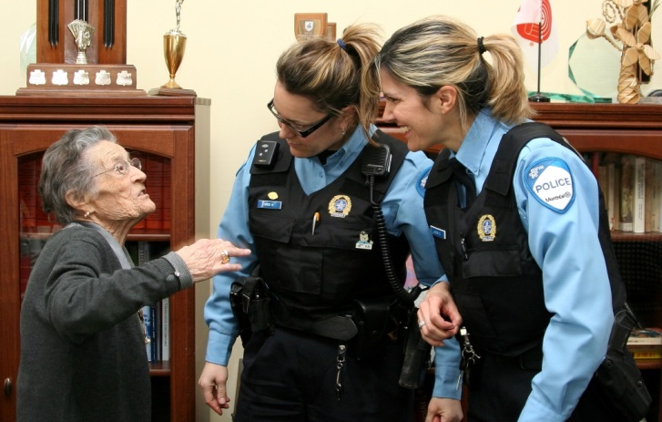
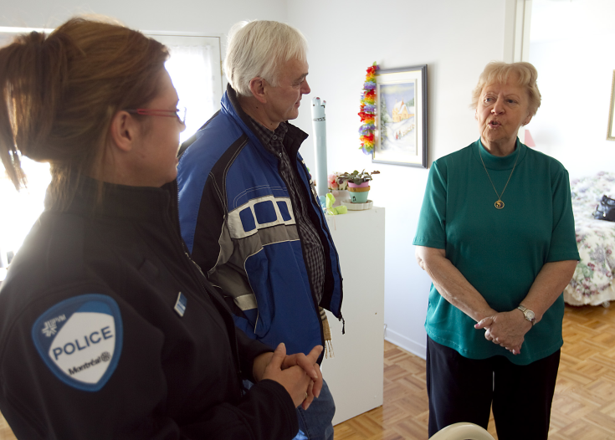
Research problem and main goal
Research Problem
Police officers are called to intervene in different situations of mistreatment, at home or in nursing homes. The detection and the assessment of risk factors and elder mistreatment are not done in a systematic manner. Although they already identify situations of mistreatment, the majority of first responders (police and firefighters) have no standardized approach to detect situations involving vulnerable seniors.
Main Goal
This 3-year project aims at developing a police practice model to counter Mistreatment of Older Adults and to better empower police officers to recognize these situations and to intervene.
13

Slide 14
Project’s pertinence
Why to develop a practice model for the police?
Police have privileged access to seniors
Police has a central role in detection, prevention and investigation
Police are an important gateway for seniors in the health and social services
In a few years, one in four people will be over 65 years
In Montreal, in one household out of nine, there is an older adult living alone
Police will be increasingly called upon to provide security for seniors
14

Slide 15
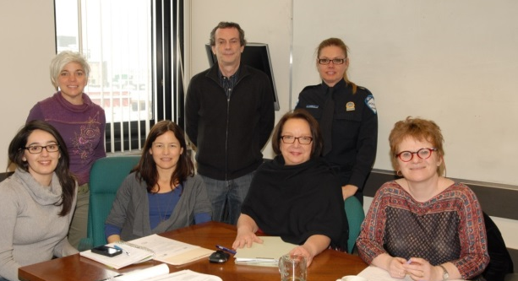
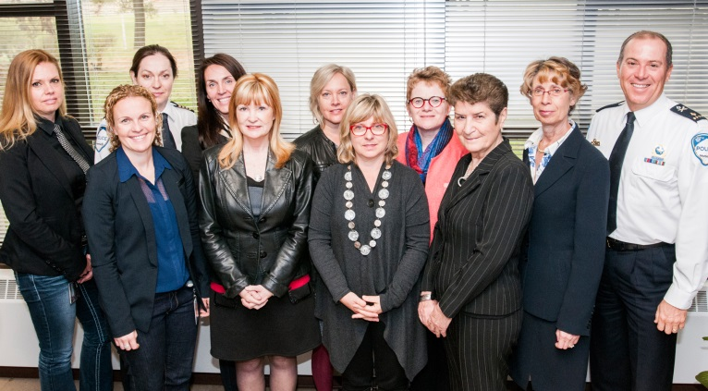
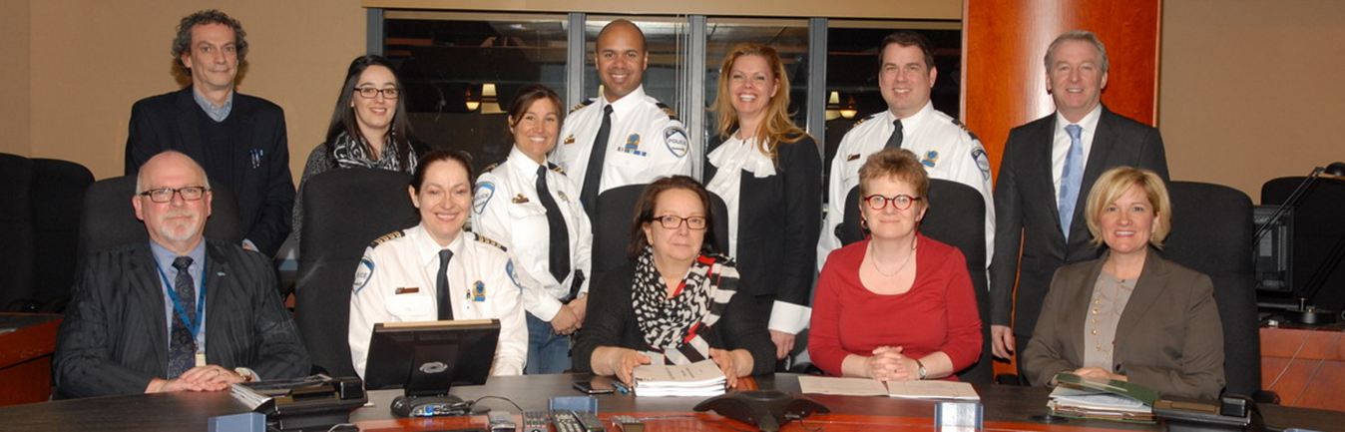
Unique research-action project
Unique partnership
between the SPVM and the Research Chair
Police + Research+ Partners
Synergy of
expertise
Operational Board
Research teams: SPVM and University of Sherbrooke - Research Chair on mistreatment of older adults
Advisory Board
15

Slide 16
Objectives
YEAR 1
Document police practices on mistreatment of older adults;
Document the police officers’ needs and practices of the City of Montreal Police Service (SPVM) regarding detection, monitoring and intersystem collaboration;
Develop a practice model (detection, intervention and follow-up) or adapt the existing ones;
Implement the practice model in a pilot-project in the SPVM, including support mechanisms to police practice;
Evaluate the implementation and effects of the practice model implemented in the pilot-project;
Review the practice model;
Implement the revised practice model within the entire SPVM;
Promote this new practice model across the Canadian Police Services, the scientific community and practitioners in the fields of health and social services.
YEAR 2
YEAR 3
16

Slide 17
Year 1. Goals 1 and 2:
Document existing practices and needs
Aim
Develop a police practice model to counter mistreatment of older adults by empowering police officers to recognize these situations and to take action.
10 data
collection
Activities
Scientific literature
125 reviewed articles
Practice and governmental literature
+ 35 publications
Inventory of Canadian practices
46 police services
Online Survey
661 police officers
Police Focus Groups (NPS)
117 police officers
Police Focus Groups (IC)
23 police officers
Observation of police intervention (cobra)
2/5 senior targeted
Individual interviews – police officers
6 police officers
Individual interviews – partners
32 organisations
Identification of SPVM’s best practices
4 CO + 8 CRO + 2 proj.
Analyses
Documentary, qualitative, quantitative and triangulation of data
17

Slide 18
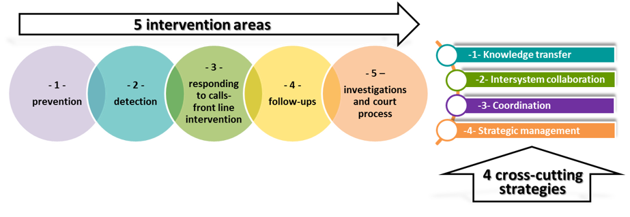
Year 2. Goal 3:
Develop a practice model
Practice schema
Basic structure of the IPAM model
18

Slide 19
Year 2. Goal 3:
Develop a practice model
Practice schema
Needs
Five intervention areas
-1-prevention
-2- detection
-3-responding to calls-front line intervention
-4- follow-ups
-5-Investigations and court process
1. Strengthen a common prevention strategy
2. Promote prevention with senior immigrants
5. Propose an operational mode (OM) for cases of mistreatment
6. Develop senior friendly communication + interaction techniques with seniors
9. Develop support for investigators
10. Optimize support for older victims
12. Promote reduction of response time
13. Improve investigators efficiency
3. Improve knowledge + better understanding of how mistreatment can be detected
4. Support patrol officers in detecting mistreatment
7. Improve the efficiency of follow-ups with seniors/mistreating persons
8. Optimize the contribution of patrol officers to the effectiveness of follow-ups with seniors
9. Better define the role of internal pivot regarding follow-ups and collaboration with partners
19

Slide 20
Year 2. Goal 3:
Develop a practice model
Practice schema
Needs
4 cross-cutting
strategies
14. Promote general awareness of all SPVM officers
15. Provide training to patrol officers related to their involvement
16. Emphasize further training for pivot-agents
17. Consider training of investigators
18. Promote joint training for police officers and their partners
1- Knowledge transfer
2-Intersystem collaboration
3-Coordination
4-Strategic management
19. Promote dialogue and better understanding of partners’ contributions
20. Promote better communication between Police/Health and social services Network (decrease barriers in information sharing)
21. Develop/strengthen operational links with partners
22. Operational Support based on Local expertise
23. Operational Support based on Regional expertise
24. Operational Support based on Corporate expertise
25. Promote practice improvement that reflects strategic vision and corporate support
20

Slide 21
Re: Your opinion
2. To what extent do you consider relevant to work in collaboration with the police in situations of elder mistreatment of older adults?
Very relevant
Quite relevant
Little or not relevant
3. To what extent do you consider relevant to work in collaboration with the police when it comes to situations of non-criminal mistreatment?
Very relevant
Quite relevant
Little or not relevant
21

Slide 22

Year 2. Goal 3:
Develop a practice model
Operational Model
Operational Board :
adapt the practice schema into an operational model
5 working subcommittees:
Prevention, detection, intervention, follow-ups and investigation
22

Slide 23
Year 2. Goal 3:
Develop a practice model
Practice Model
components
FRAMEWORK
Local intervention Directive
-Detection pocket tool
-Referral to services form
-Summary of definitions
-Intervention flowchart
PARTNERSHIP
- CAVAC (Crime victims assistance centre)
- Health and social services
- Key local partners
COMMUNICATION
Activities and Communication Plan
internal/external/management
EVALUATION
Evaluation strategy
-Implementation
-Effects
TRAINING/TOOLS
- Training intranet module
-Detection pocket tool
- Aide à la tâche
- Guide: mistreatment and criminal code
23

Slide 24
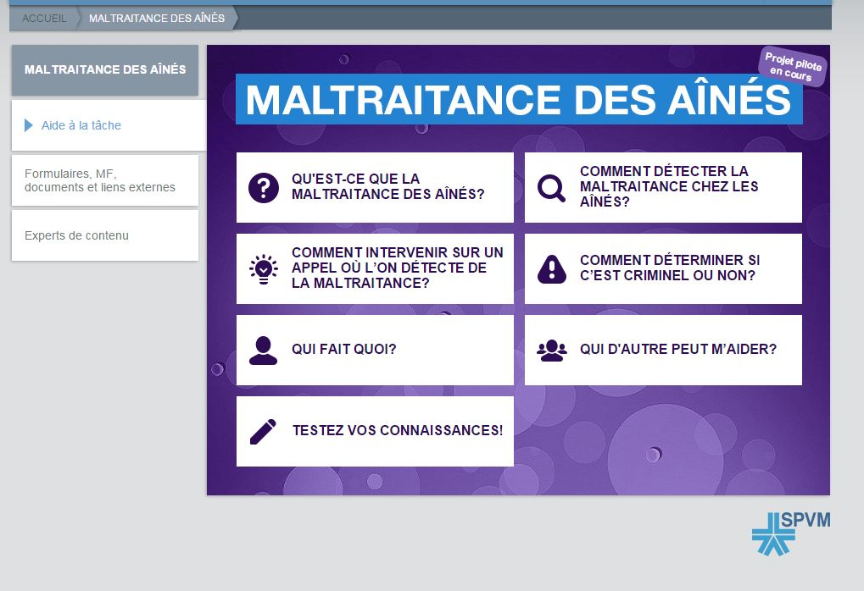
Year 2. Goal 3:
Develop a practice model
Practice Model
Framework and training
FRAMEWORK:
Local intervention directive
TRAINING:
Intranet module
7 sections and 21 subsections
Police intervention principles
Key definitions
Police intervention roles
Appendices:
A. Detection pocket tool (next slide)
B. Referral to services form
C. Summary of key definitions related to mistreatment (forms, types)
D. Intervention flowchart
24

Slide 25
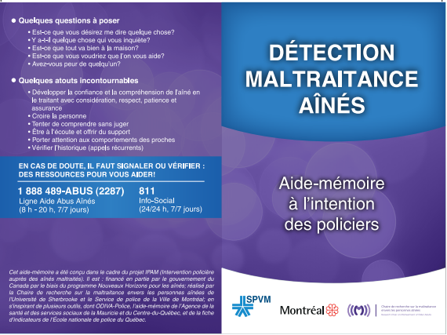
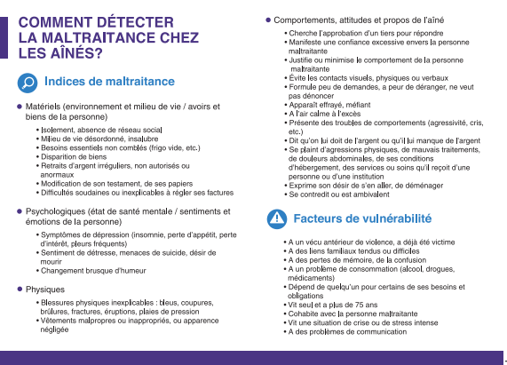
Year 2. Goal 3:
Develop a practice model
Practice Model
Tools
Local Intervention Directive (appendix A): Detection Pocket Tool
25

Slide 26
Year 2. Goal 3:
Develop a practice model
Practice Model
Operational structure
OPERATIONAL STRUCTURE
Corporative Support Structure
Central Structure
Intersystem collaboration Structure
Corporate
2 executive members
1 Champion- Officer
Corporate Partners
Training department
Regional
1 Champion- officer/ division
Regional Partners
4 divisions:
North, Est, West, South
Communications department
Local
1 Champion- Officer/ NPS
Local Partners
32 Neighbourhood Police Stations (NPS)
26

Slide 27
Year 2. Goal 4:
Implement the practice model
Practice Model
Pilot-Project
Pilot project implementation: two phases
Phase-1 (May– October 2015): 3 NPS, 3 Divisions (North, Est, West)
Pre-launch April 29th 2015
Implementation begins May 13th 2015
Phase-2 (November 2015– February 2016) : inclusion of 4 NPS, and Southern Division
Pre-launch November 3rd 2015
Implementation begins November 24th 2015
27

Slide 28
Year 2. Goal 5:
Evaluate the implementation and effects of the practice model
Evaluation has a double aim:
Implementation
Effects on police practice
Aim:
Did the implementation work?
What key elements favored or hindered the implementation?
Aim:
To observe the project's impact on police practice.
28

Slide 29
Year 2. Goal 5:
Evaluate the implementation and effects of the practice model
MIXED METHOD DESIGN
Police officers
Investigators
Local champion officers
Regional champion officers
Corporate champion officer
Chiefs
Executive members
Partners
Qualitative and quantitative
11 evaluation activities : interviews, focus groups, questionnaires, analysis of police reports
Over 300 participants or sources
Implementation report (winter 2016)
Effects on police practice report (winter 2016)
29

Slide 30
Year 2. Goal 5:
Evaluate the implementation and effects of the practice model
Preliminary results
Implementation of pilot- project Phase-1
Key role of the Operational Board in the development and implementation of practice model
Champion officers (regional and local) play a central role in the implementation of the model
Engagement in a self-reflective attitude and in a continuous improvement approach
Coaching, mentorship and internship strategies for new champions
Dissemination of the practice model within the SPVM: importance of promotion through concrete cases and successful applications of the model
Key role of partners: CAVAC (Crime victims assistance centre), public Health and Social services and local community-based organizations
Intervention in «team» (local champion officer + community social worker) proved to be one of the most valued intersectoral practices for local champion officers
30

Slide 31
Year 3. Goal 6:
Review and adjust practice model
Adjustments
Main adjustments based on evaluation of the implementation of pilot-project Phase-1
Update of the local intervention directive
Reinforcement of management communication
Update of the operational structure: role of corporate champion officer
Reinforcement of training activities
Reinforcement of activities enabling intersectoral work
31

Slide 32
Year 3: Goal 8:
Promote this new practice model …
Canadian Police Services
Accomplished:
To come:
Written communication :
Summary of the results of Year 1 (distributed to 46 police services)
Working Committee of the Ministry of Public Security of Quebec (MSP)
Oral communications:
Congress of the Quebec’s Criminology Society (Quebec, 28-30 October 2015)
Canadian Conference on Elder Law (Vancouver, 12 Nov. 2015)
Written communications :
Synthesis of project results
Guide for the implementation of the police model
Oral communications:
Presentation at the National Police School of Quebec
Symposium Intersection
Scientific community and practitioners (Heath and Social Services)
Accomplished:
To come:
Written communications :
Summary of the results of Year 1 (distributed to partners, researchers and public at large)
Published article : Vie et Vieillissement (April 2015)
Oral communications:
Quebec (6): Nicolet, Sherbrooke, Beaupré, Montréal (3)
Canada (3): Niagara Falls, Calgary et Vancouver
International (3): Belgium, India, England
Written communications :
Quebec: 1 to come (2016)
Canada: 1 to come (2016)
International: 3 to come (2016)
Oral communication:
(IFA) 13th Global Conference on Ageing (Australia)
32

Slide 33
Next steps
33

Slide 34

Objectives
YEAR 1
Document police practices on mistreatment of older adults;
Document the police officers’ needs and practices of the City of Montreal Police Service (SPVM) regarding detection, monitoring and intersystem collaboration;
Develop a practice model (detection, intervention and follow-up) or adapt the existing ones;
Implement the practice model in a pilot-project in the SPVM, including support mechanisms to police practice;
Evaluate the implementation and effects of the practice model implemented in the pilot-project;
Review and adjust the practice model;
Implement the revised practice model within the entire SPVM; June 2016
Promote this new practice model across the Canadian Police Services, the scientific community and practitioners in the fields of health and social services.
YEAR 2
YEAR 3
34

Slide 35
Re: Your interest
4. Would you be interested in developing a similar project to IPAM with the police service of your area?
Yes
No
5. Would you be interested in receiving the summary of results of the IPAM project (April-May 2016)?
Yes
No
If you are interested, you can send an email to Luisa Diaz (Luisa.Diaz@USherbrooke.ca), specifying the language of documents (English or French).
35

Slide 36

Questions
36

Slide 37


For more information about IPAM
Marie Beaulieu, Ph.D
Professor, School of Social Work, University of Sherbrooke.
Chairholder, Research Chair on mistreatment of older adults.
Principal Investigator IPAM project.
marie.beaulieu@usherbrooke.ca
Michelle Côté, Ph.D
Head of Research and Strategic Planning Division, SPVM.
Co-investigator IPAM project.
michelle.cote@spvm.qc.ca
37

Slide 38

Stay in touch with the CNPEA
Useful resources, recent research and publications, webinars and blog posts – It’s all on www.cnpea.ca
Please take a minute to answer a few quick questions about your experience of this webinar: http://fluidsurveys.com/surveys/cnpea/cnpea-webinar-feedback/
Please fill out this online feedback form by January 31, 2016
(If this link is not working, copy and paste it into an internet browser)
Twitter: @cnpea

